Slide 1
Creating a Culture of Inclusion for Your Hybrid Teams
with Peer Coaching on Critical Skills
Engage ● Coach ● Perform℠

Slide 2
Madhukar Govindaraju , Founder & CEO of Numly

Slide 3
Two Intertwined, But Different Concepts
Refers to the full spectrum of human demographic differences.
Policies provide necessary clarity.
Easily quantified.
Refers to a cultural and environmental feeling of belonging.
Measured by the extent to which employees feel valued, respected, and accepted.
Requires a more nuanced approach.
Notes:
understanding them as fundamentally different things is essential, because it divides and clarifies the primary challenge for leaders: understanding the implication that demographic variety has on business performance, and creating an environment that invites the full spectrum of employee perspectives and maximizes them.
https://www.gallup.com/workplace/242138/requirements-diverse-inclusive-culture.aspx

Slide 4
Diversity Doesn’t Work Without Inclusion
“In the context of the workplace, diversity equals representation. Without inclusion, however—the critical connections that attract diverse talent, encourage their participation, foster innovation, and lead to business growth—won’t happen.”
“The Skills of the future are not technical, they’re behavioral.”
Josh Bersin
Notes:
understanding them as fundamentally different things is essential, because it divides and clarifies the primary challenge for leaders: understanding the implication that demographic variety has on business performance, and creating an environment that invites the full spectrum of employee perspectives and maximizes them.

Slide 5
Poll: What’s the current state of DEIB in your company?
A. It’s a permanent part of our mission/vision
B. We have some initiatives in place
C. We’re interested, but haven’t started yet
D. We’re interested, but don’t know where to start
E. It’s not a priority for my company
F. I don’t know.
“The Skills of the future are not technical, they’re behavioral.”
Josh Bersin
Notes:
understanding them as fundamentally different things is essential, because it divides and clarifies the primary challenge for leaders: understanding the implication that demographic variety has on business performance, and creating an environment that invites the full spectrum of employee perspectives and maximizes them.

Slide 6
Overall Sentiment on DEIB is Markedly Negative
Source: Deloitte’s 2021 Report on Equity

Slide 7
The Challenges
Creating an environment that invites the full spectrum of perspectives
Tailoring it for the hybrid workforce
Cultivating the leadership skills to lead, inspire, and foster inclusion
“The Skills of the future are not technical, they’re behavioral.”
Josh Bersin

Slide 8
Companies Must…
Adopt a systematic, top-down approach to inclusion and diversity
Increase diverse representation, especially in leadership roles
Strengthen leadership and accountability for meeting DEIB goals
Take bold steps to strengthen inclusion
Enable equality of opportunity through fairness and transparency
Promote openness, tackling bias and discrimination
Foster belonging through support for multivariate diversity
Build leaders that foster inclusion

Slide 9
Inclusion is Everyone’s Responsibility
Source: Workable DE&I Workplace Survey

Slide 10
But few know how.

Slide 11
It Starts with Leadership
“The Skills of the future are not technical, they’re behavioral.”
Josh Bersin
“What leaders say and do makes up to a 70% difference as to whether an individual reports feeling included.”
Notes:
understanding them as fundamentally different things is essential, because it divides and clarifies the primary challenge for leaders: understanding the implication that demographic variety has on business performance, and creating an environment that invites the full spectrum of employee perspectives and maximizes them.

Slide 12
6 Signature Traits for Inclusive Leadership
Visible commitment to DEIB
Humility
Awareness of bias
Curiosity about others
Cultural intelligence
Effective collaboration
Source: Harvard Business Review
Notes:
https://hbr.org/2020/03/the-key-to-inclusive-leadership

Slide 13
Start with Leaders But Don’t Stop There
The Problem: DEIB training/mentoring doesn’t create the behavioral changes needed, which prevents scaling an inclusive culture.
The Solution: Enable all employees to coach each other, provide an opportunity to practice inclusive behaviors, and build a network of allies/sponsors across the company.

Slide 14
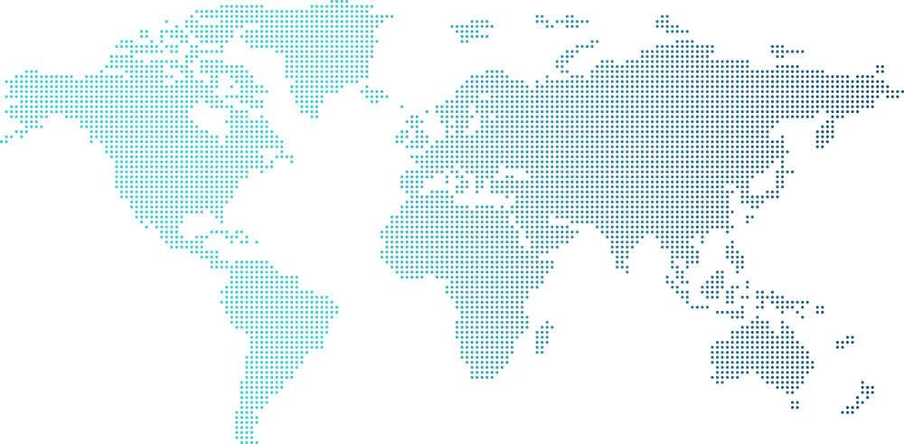
Coaching Correlates with Higher Organizational Resilience
Correlates positively with higher employee engagement, financial performance, and revenues above that of industry peers
57% Improved Team Functioning
56% Increase in Engagement
51% Increase in productivity
45% Improved Employee Relations
21% Faster Leadership Development
Source: Forbes Dr, Tracy Cocivera, Coaches Council , 2018

Slide 15
Peer Coaching: A Different Approach
Traditional
New
Only executives receive coaching
1:1
Hard to show improvements
One-off event
Outside experts
Coach everyone!
Many to many
Quantify with rich analytics
Ongoing
Peers coaching each other
LIMITED
Notes:
Add “limited” across the old approach; the now vs. next

Slide 16
What is Peer Coaching?
A confidential process through which two or more colleagues work together to reflect on current practices and challenges; expand, refine, and build new skills; share ideas; teach one another; and/or solve problems in the workplace.
Connect | Trust | Collaborate

Slide 17
Why Peer Coaching?
Provides a 360-degree view of the employee’s performance
Empowers employees to learn critical skills
Increases camaraderie and engagement
Makes coaching more relevant, contextual, and scalable
Enables learners to expand their organizational network
Empowers coaches to develop leadership skills
The connections that build bridges and foster inclusion

Slide 18
Why Now?

Slide 19
Hybrid Work Has Introduced A New Set of Challenges
What We Want
What We Get
Productivity
Flexibility
Sense of belonging
Upskilling and reskilling
Anxiety and burnout
Uncertainty
Dis-engagement
Ineffective learning programs
Notes:
Given the last 18 months we are in a new reality of how employees engage within companies. We want productivity to remain with the new “work world”. Employees want to work in a flexible way. Hybrid is the new way to work. At the same time wanting connection and opportunities to learn and grow. Employees have said they need a sense of belonging and the feeling of disconnected.

Slide 20
Poll: Where Would You Start?
A: New Hires
B: New People Managers
C: All People Managers
D: Sales
E: Marketing F: Customer Success G: R&D H: Entire company

Slide 21
Numly Provides A Guided and Structured Process
Identify and measure skill gaps for everyone in the organization
Measure progress
and make
data-driven decisions
Facilitate active coaching through skill programs and guided processes

Slide 22
Cultivate Leadership Skills That Foster Inclusion

Slide 23
What’s the State of DEIB in Your Organization?
Find out now.
Email contact@numly.io to take a 27-question survey and get your custom report.

